Slide 1
High-lights from the Oslo results on level densities
Energy
Fission
Bn ≈ 5 MeV
Quasi-continuum
Millions of states/MeV
Magne Guttormsen
Department of Physics
University of Oslo
Spin

Slide 2
Compilation on Oslo NLDs
The web page: http://ocl.uio.no/compilation
A. Schiller et al., Phys. Rev. C63, 021306(R) (2001): (3He,4He)161Dy
U. Agvaanluvsan et al., Phys. Rev. C70, 054611 (2004): (3He,4He)170Yb
U. Agvaanluvsan et al., Phys. Rev. C70, 054611 (2004): (3He,3He)171Yb
U. Agvaanluvsan et al., Phys. Rev. C70, 054611 (2004): (3He,4He)171Yb
U. Agvaanluvsan et al., Phys. Rev. C70, 054611 (2004): (3He,3He)172Yb
U. Agvaanluvsan et al., Phys. Rev. C70, 054611 (2004): (3He,4He)172Yb
R. Chankova et al., Phys. Rev. C73, 034311 (2006): (3He,4He)93Mo
R. Chankova et al., Phys. Rev. C73, 034311 (2006): (3He,3He)94Mo
R. Chankova et al., Phys. Rev. C73, 034311 (2006): (3He,4He)95Mo
R. Chankova et al., Phys. Rev. C73, 034311 (2006): (3He,3He)96Mo
R. Chankova et al., Phys. Rev. C73, 034311 (2006): (3He,4He)96Mo
R. Chankova et al., Phys. Rev. C73, 034311 (2006): (3He,3He)97Mo
rho170yb4he
No Ex(MeV) Rho(1/MeV) dRho(1/MeV)
1 0.037 0.326E+01 0.474E+00
2 0.157 0.365E+01 0.583E+00
3 0.277 0.397E+01 0.654E+00
4 0.397 0.469E+01 0.838E+00
5 0.517 0.467E+01 0.108E+01
6 0.637 0.535E+01 0.126E+01
7 0.757 0.719E+01 0.173E+01
8 0.877 0.105E+02 0.200E+01
9 0.997 0.122E+02 0.216E+01
10 1.117 0.217E+02 0.275E+01
11 1.237 0.346E+02 0.349E+01
12 1.357 0.511E+02 0.402E+01
13 1.477 0.668E+02 0.516E+01
14 1.597 0.831E+02 0.597E+01
15 1.717 0.910E+02 0.851E+01
16 1.837 0.111E+03 0.943E+01
17 1.957 0.130E+03 0.121E+02
18 2.077 0.160E+03 0.142E+02
19 2.197 0.201E+03 0.167E+02
20 2.317 0.307E+03 0.206E+02
21 2.437 0.384E+03 0.255E+02
22 2.557 0.518E+03 0.337E+02
23 2.677 0.655E+03 0.430E+02
24 2.797 0.809E+03 0.589E+02
25 2.917 0.847E+03 0.735E+02

Slide 3
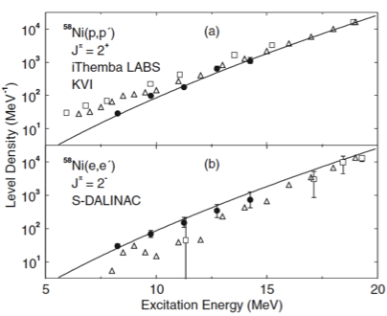
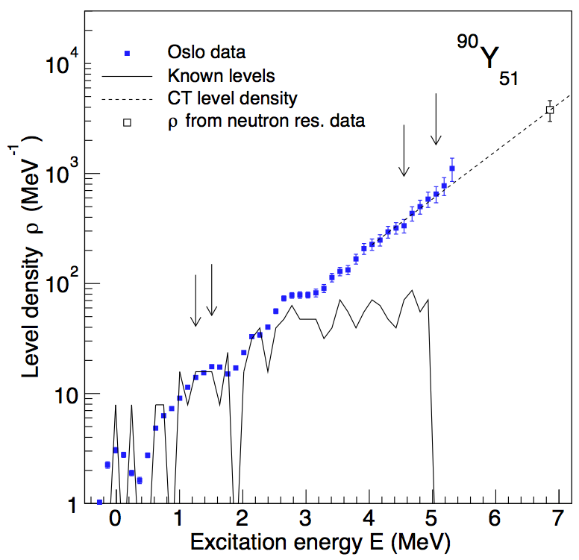
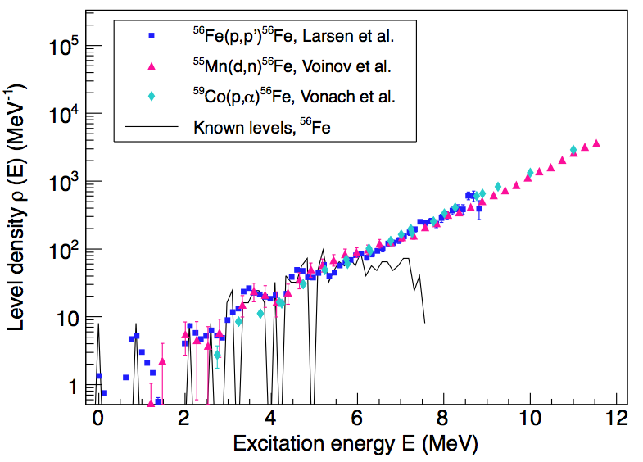
Techniques to measure level density
Discrete levels (Ex < 2 - 3 MeV or < 50 - 100 levels/MeV)
Neutron/proton resonances (Ex = Sn or Sp)
Particle evaporation spectra (Ex = 4 - 15 MeV)
Spin/parity resolved level densities from (p,p´) or (e,e´)
Ericson fluctuations (Ex ~ 15 MeV)
Primary γ spectra with the Oslo method (Ex < Sn)
Kalmykov et al.,
PRL 99,
202502 (2007)
A.C. Larsen et al.,
PRL 111,
242504 (2013)
M. Guttormsen et al.,
PRC, (2014), in press

Slide 4
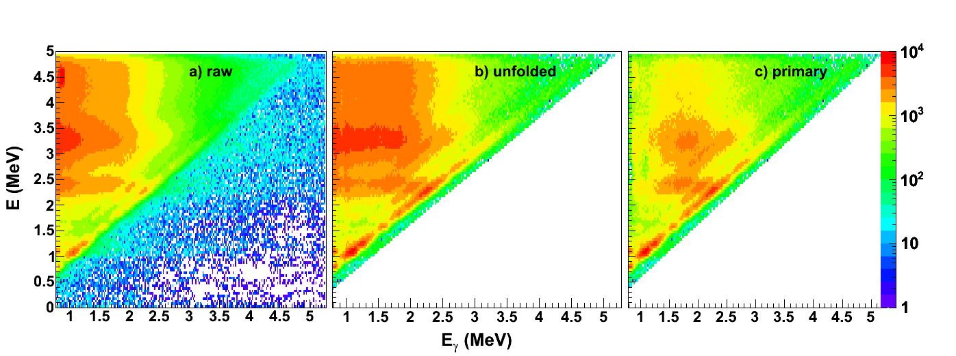
Simultaneous extraction of γSF and NLD
P(E,E_{γ})
Level density Trans. coeff.
ρ(E_{f}) T(E_{γ})
Fermi’s golden rule Brink hypothesis
M. Guttormsen et al., NIM A374 (1996) 371
M. Guttormsen et al., NIM A255 (1987) 518
A. Schiller et al., NIM A447 (2000) 498
Analysis of possible systematic errors:
A.C. Larsen et al., Phys. Rev. C 83, 034315 (2011)

Slide 5
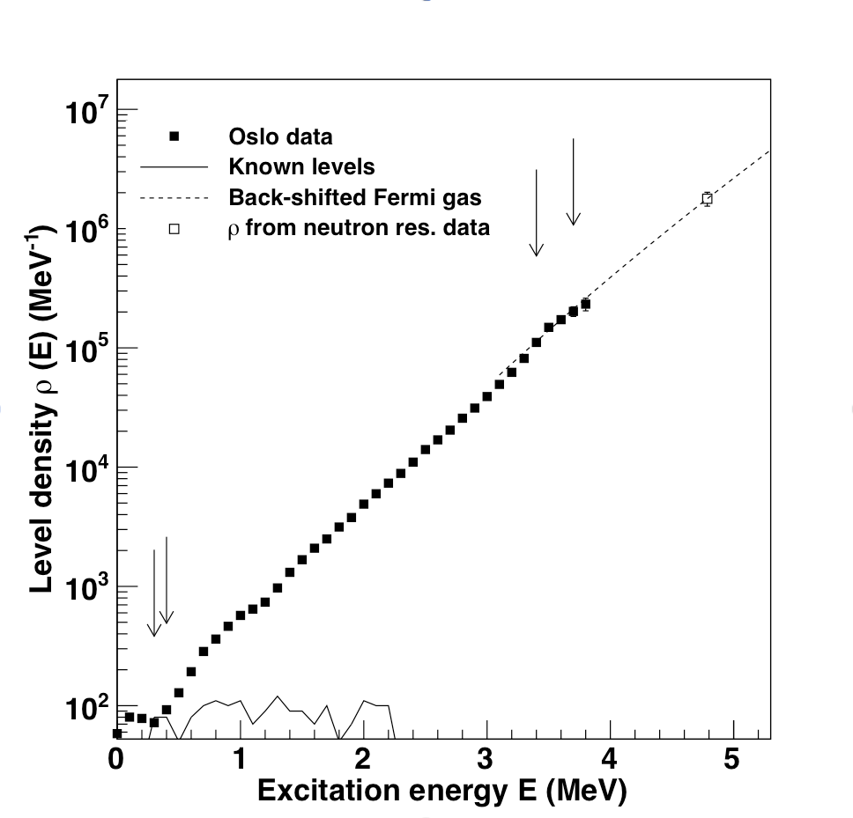
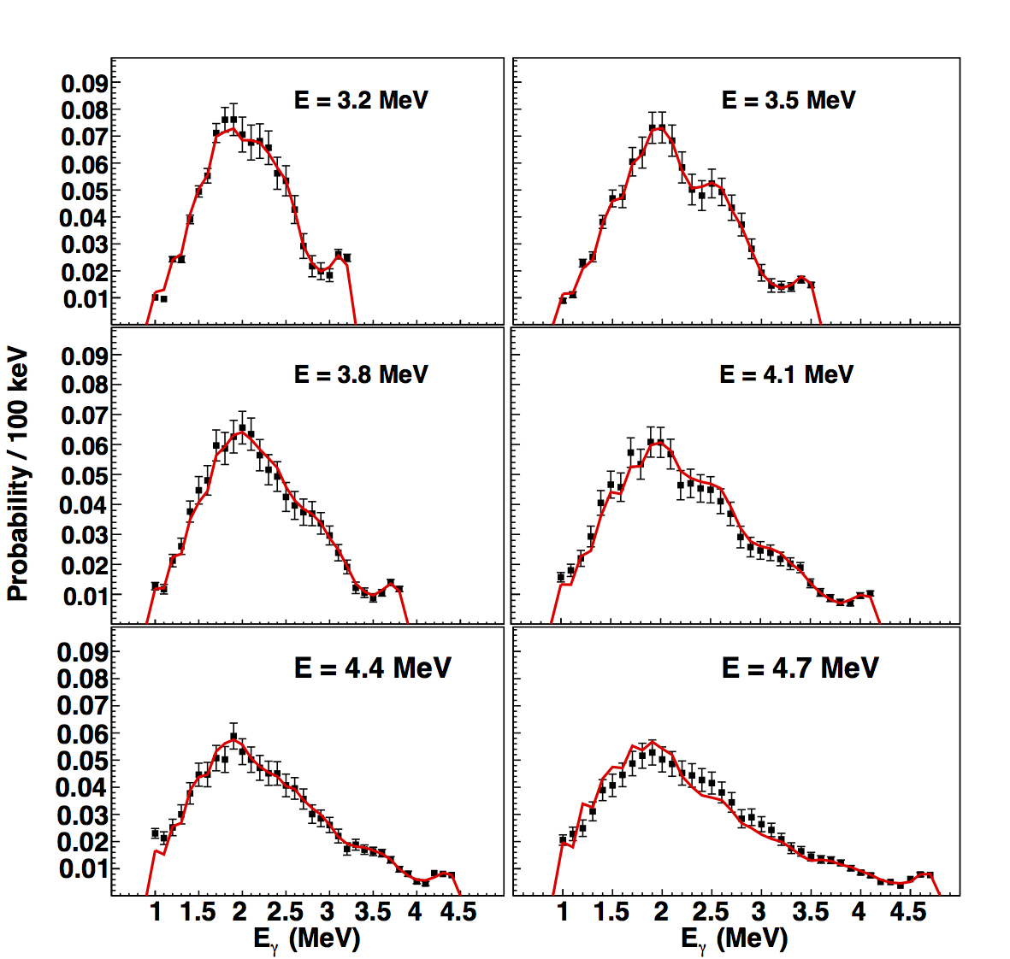
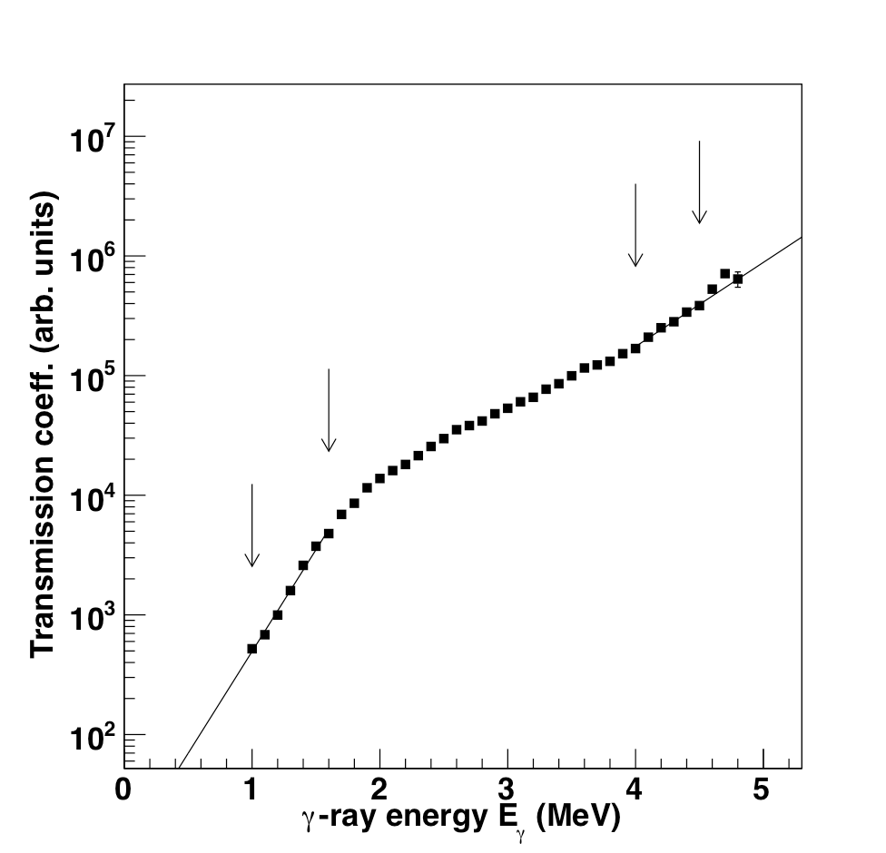
Does it work?
P(E,E_{γ}) = ρ(E_{f}) . T(E_{γ})

Slide 6
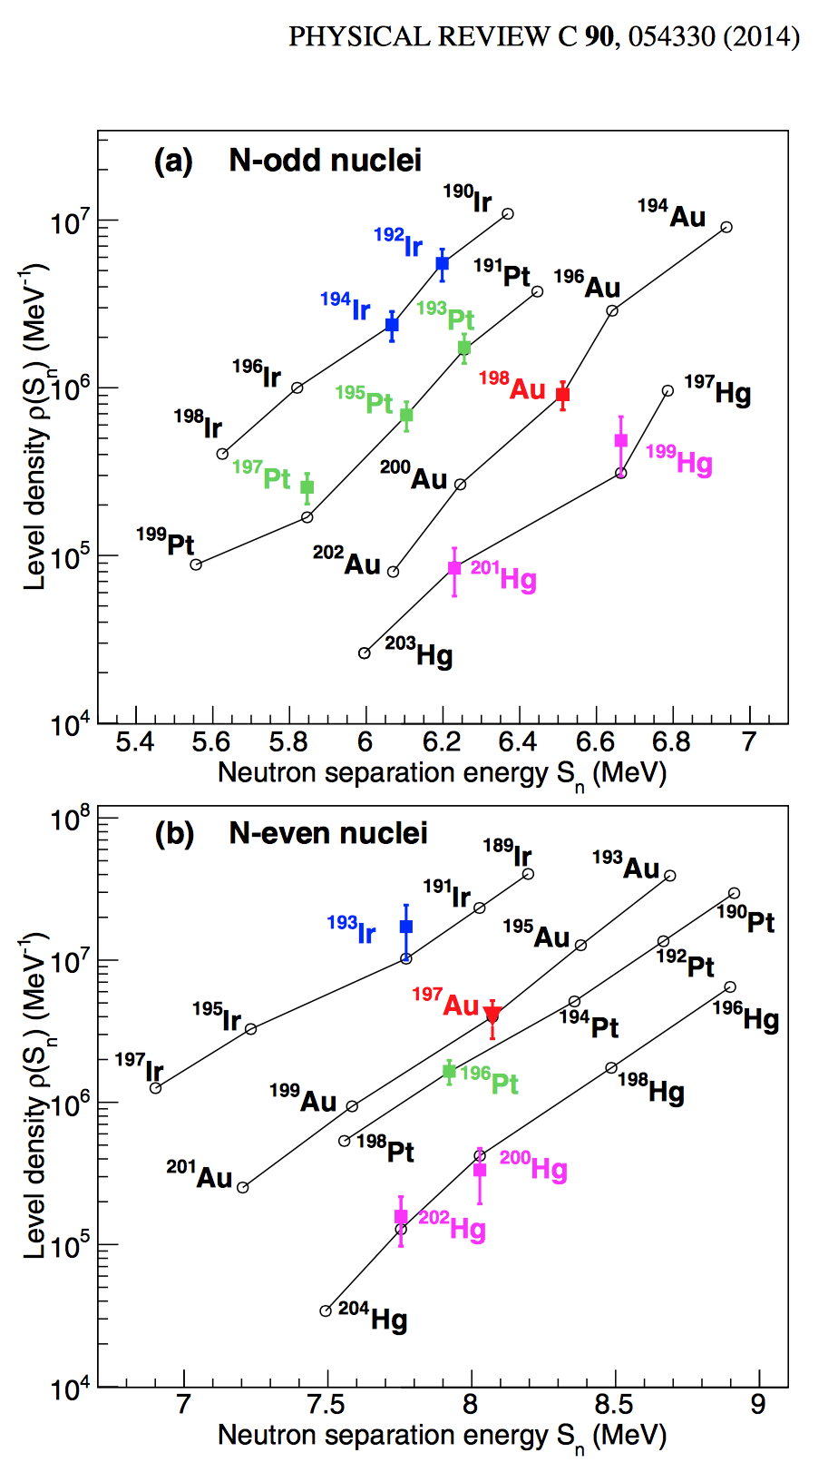
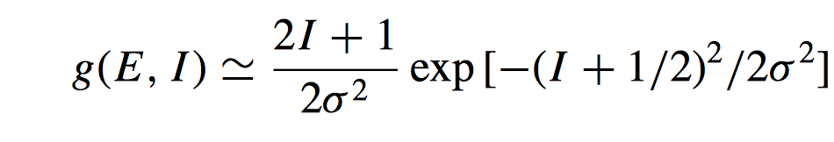
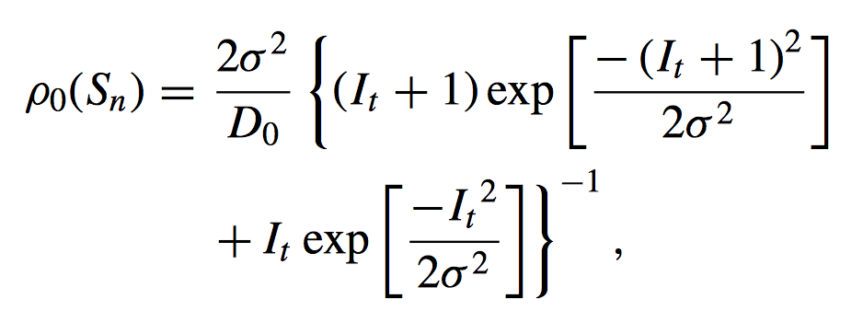
Normalization
ln ρ
E _{x}

Slide 7
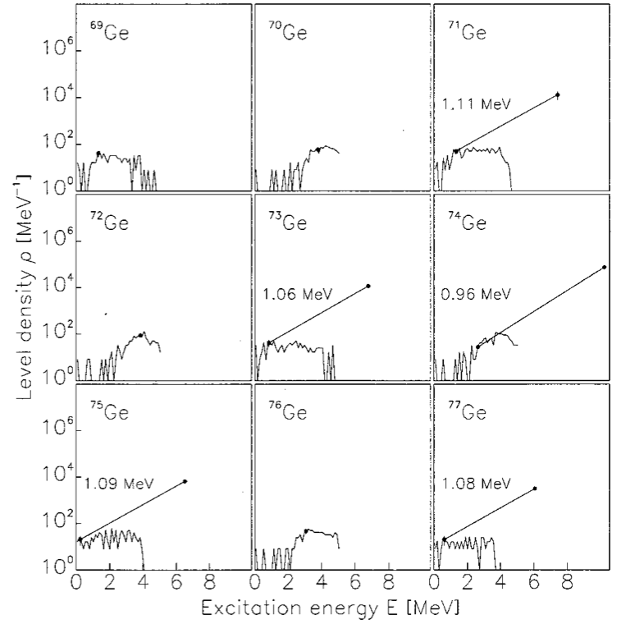
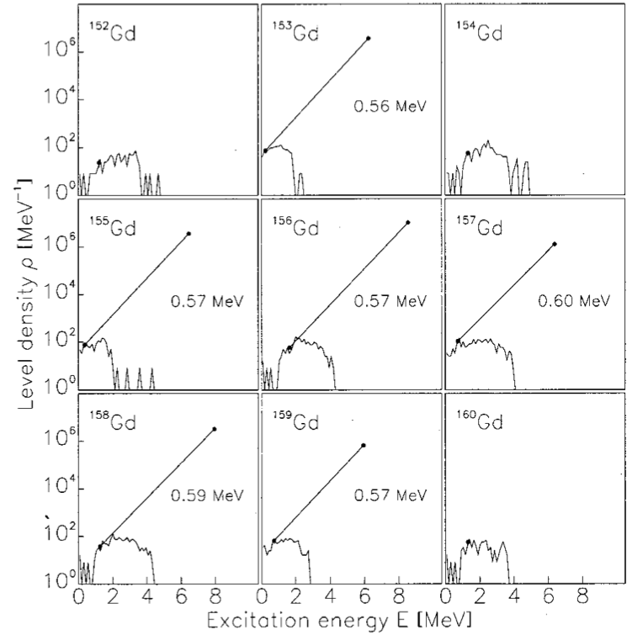
Predictions
^{M. Guttormsen et al.,}
^{PRC 63, 044301 (2001)}

Slide 8
Light mass region, ^{56,57}Fe

Slide 9
Shell model calculations ^{56,57}Fe
B.A. Brown and A.C. Larsen,
PRL 113, 252502 (2014)

Slide 10
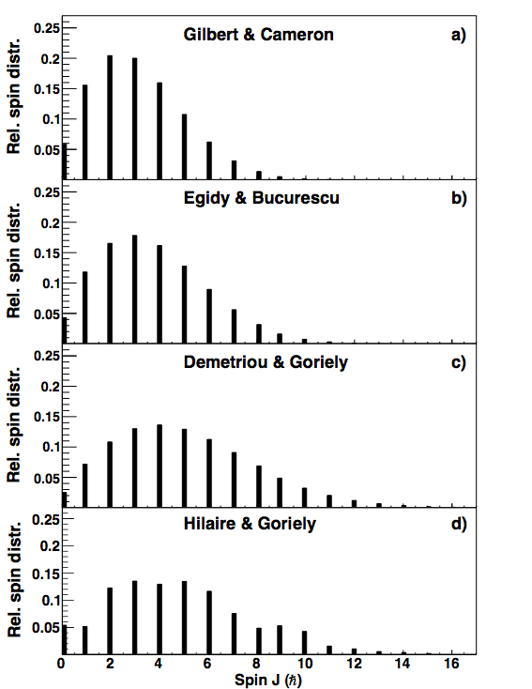
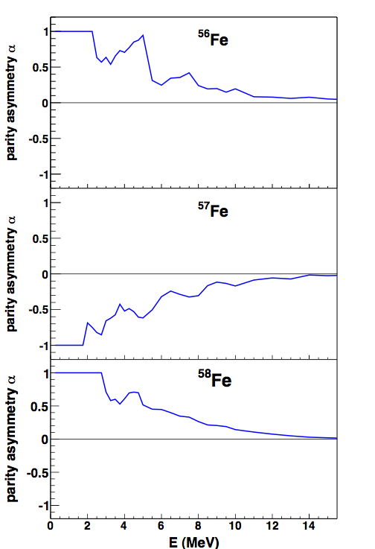
Parity and spin distributions
Spin distribution
Parity dependence
[von Egidy et al., NP A481, 189 (1988)]
[Goriely et al., PRC 78, 064307 (2008)]
[von Egidy and Bucurescu, PRC 72, 044311 (2005)]
[Demetriou and Goriely, NP A695, 95 (2001)]
[Hilaire and Goriely, NP A779, 63 (2006)]

Slide 11
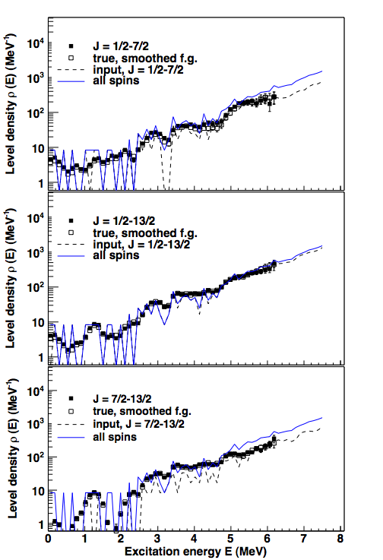
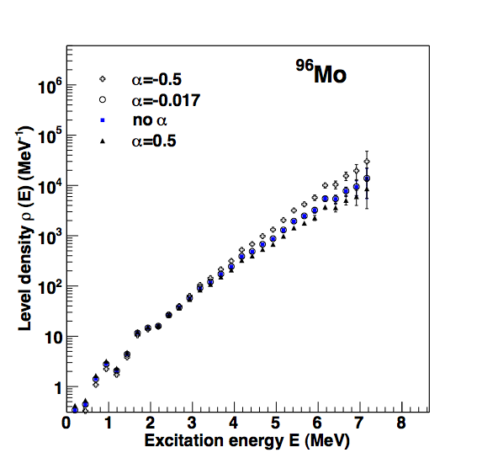
Test of the Oslo method Simulations with DICEBOX
[Larsen et al., PRC 83, 034315 (2011)]

Slide 12
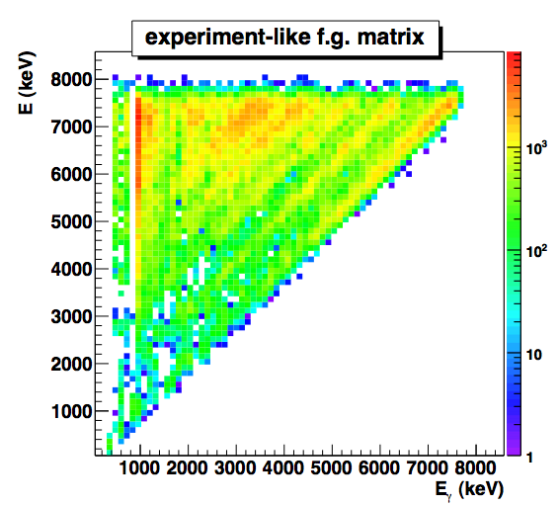
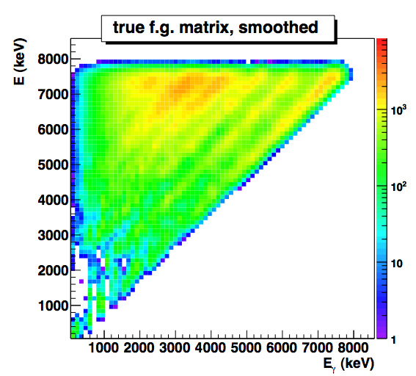
Test of the Oslo method, artificial ⁵⁷Fe
[Larsen et al., PRC 83, 034315 (2011)]

Slide 13
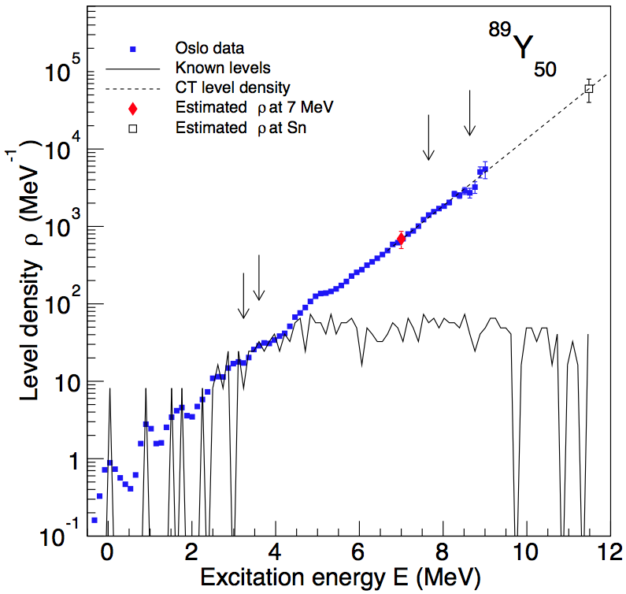
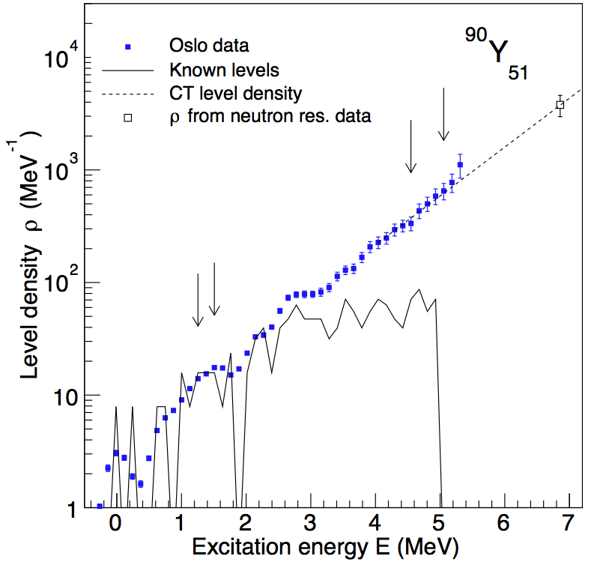
Light mass region, ^{89,90}Y
M. Guttormsen et al., PRC 90, 044311 (2014)

Slide 14
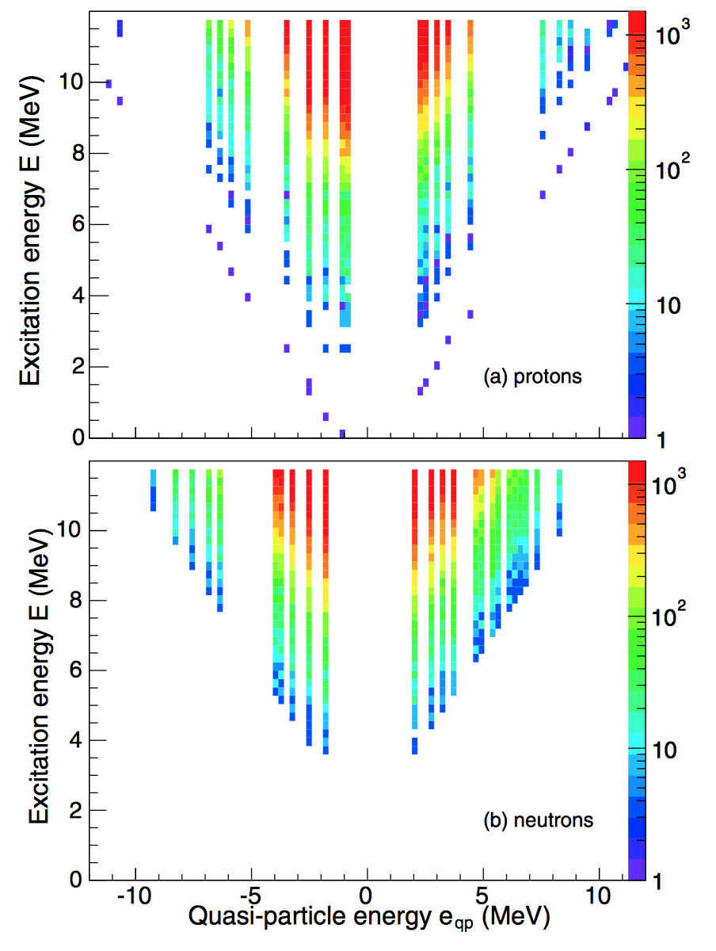
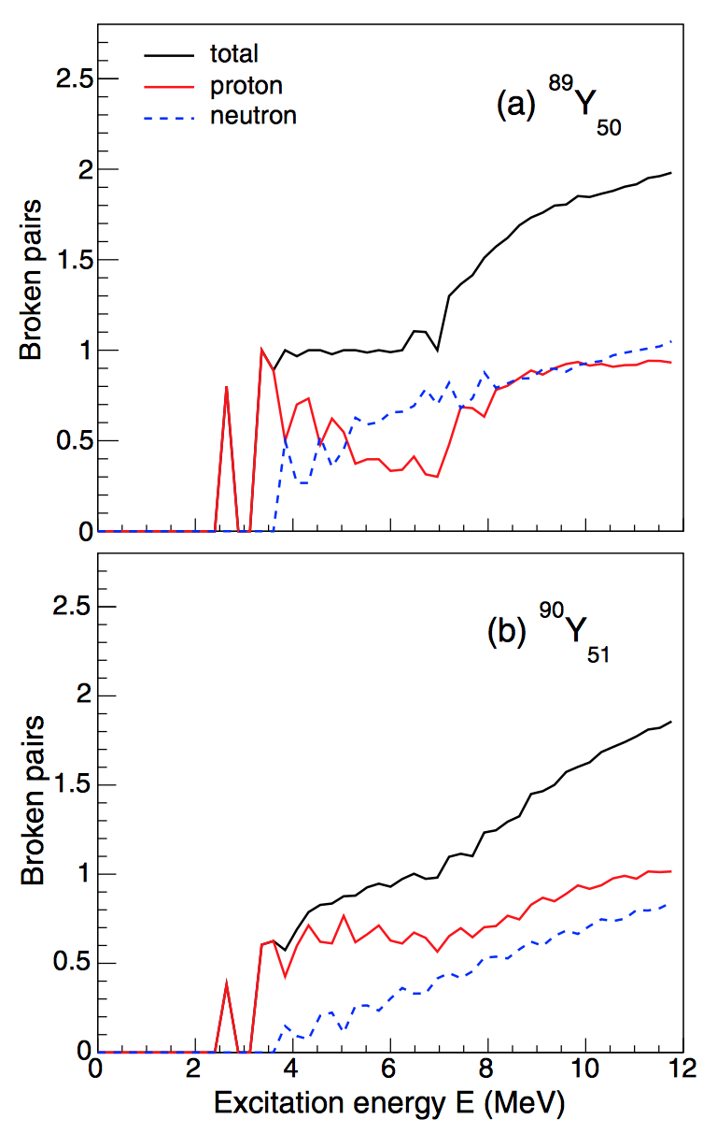
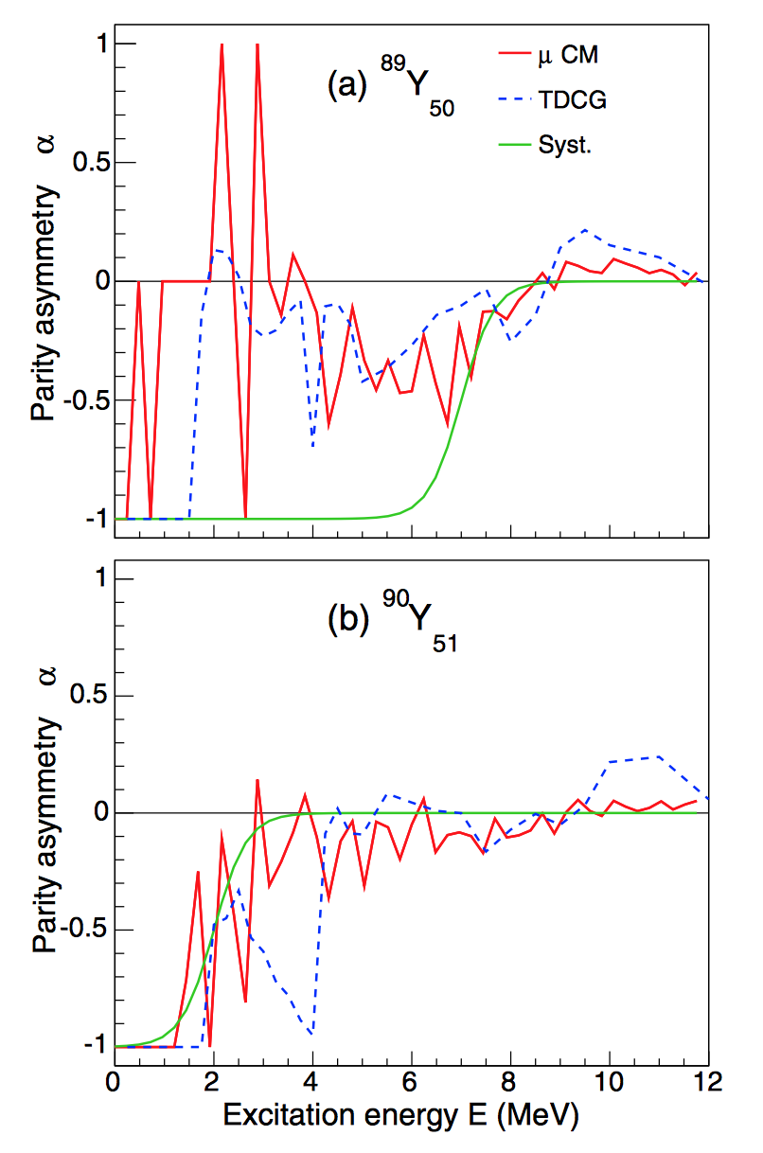
Combi ^{89,90}Y
M. Guttormsen et al., PRC 90, 044311 (2014)

Slide 15
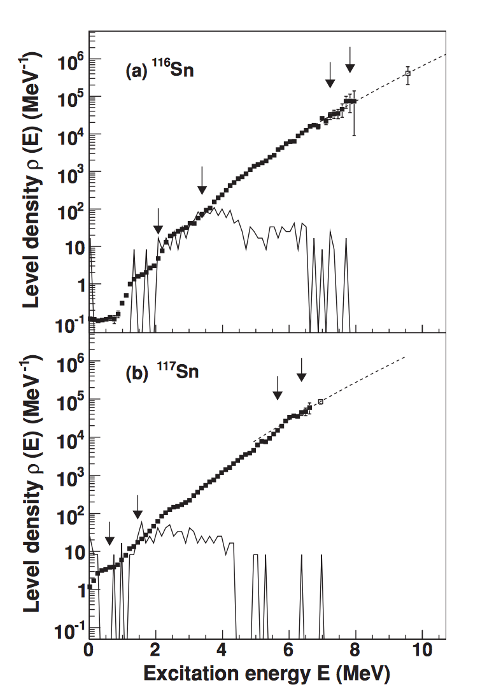
Breaking of Cooper-pairs in ^{116,117}Sn
U. Agvaanluvsan et al., PRC 79, 014320 (2009)

Slide 16
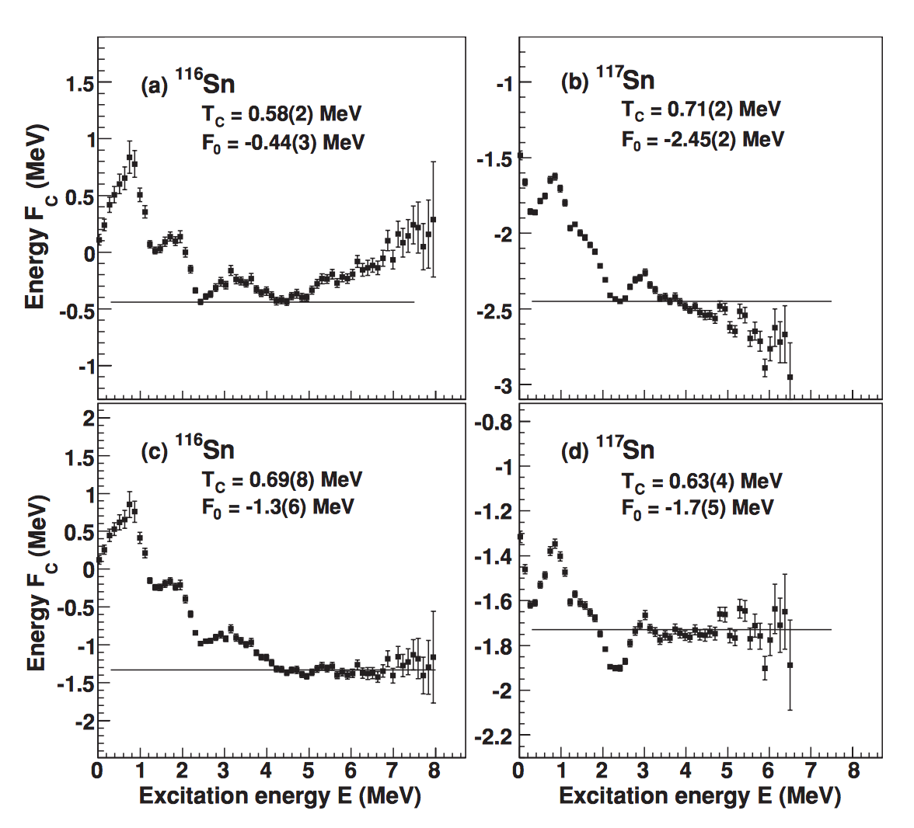
Breaking of Cooper-pairs in ^{116,117}Sn
F_{c}(E) = E – T_{c} S(E)
F_{c}(E₁) = F_{c}(E₂) =F₀
Jooyoung Lee and J. M. Kosterlitz,
Phys. Rev. B 43, 3265 (1991)
U. Agvaanluvsan et al., PRC 79, 014320 (2009)

Slide 17
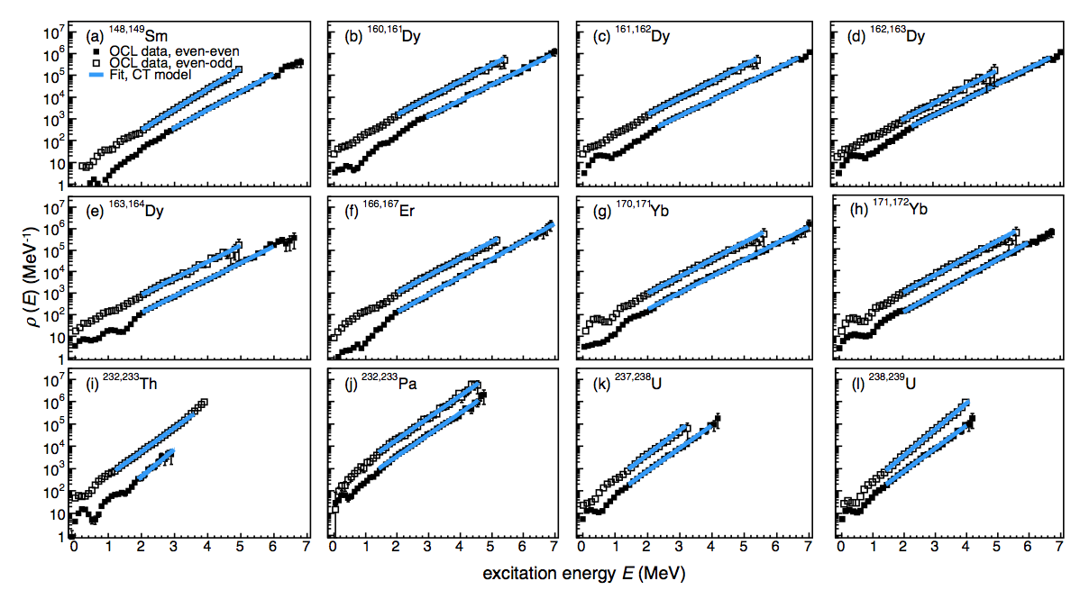
Constant-temperature level densities

Slide 18
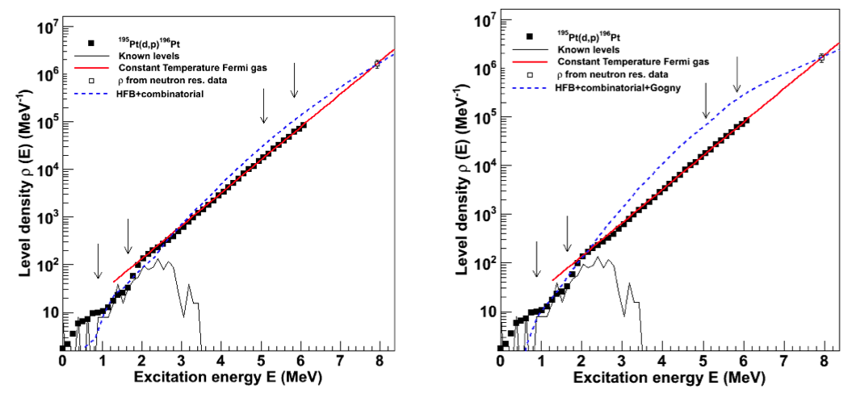
Modeling level density in ¹⁹⁶Pt
F. Giacoppo et al., PHYSICAL REVIEW C 90, 054330 (2014), and privat communication (2014)
S. Goriely et al., PRC 78, 064307 (2008) S. Hilaire et al., PRC 86, 064317 (2012)

Slide 19
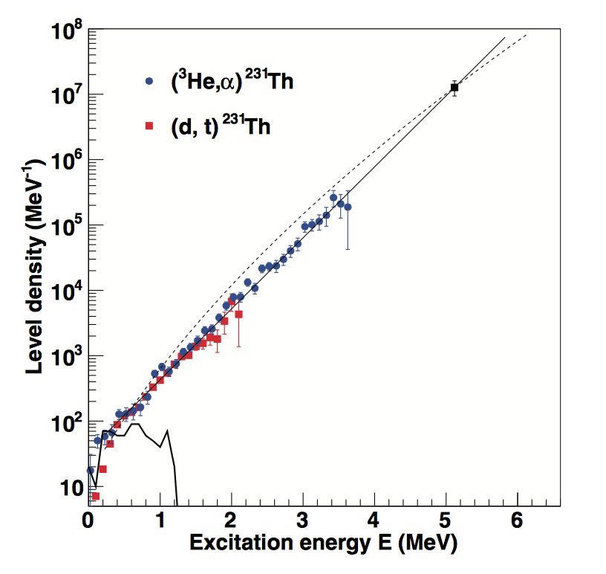
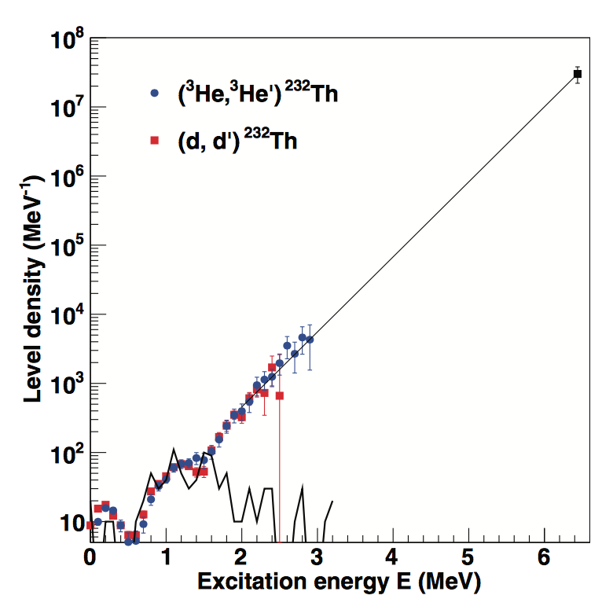
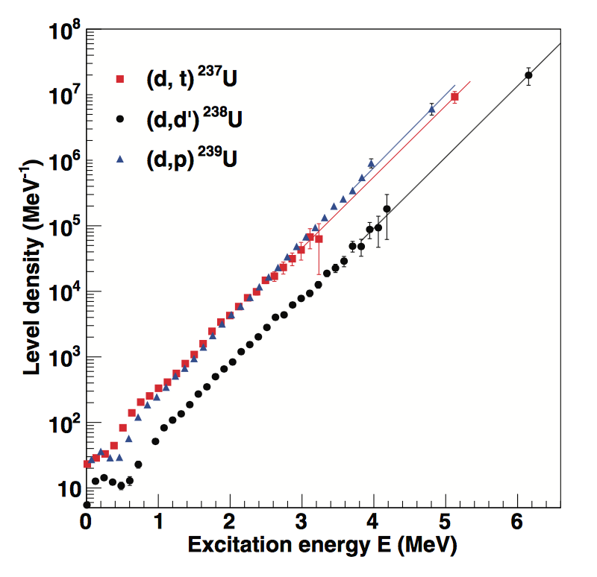
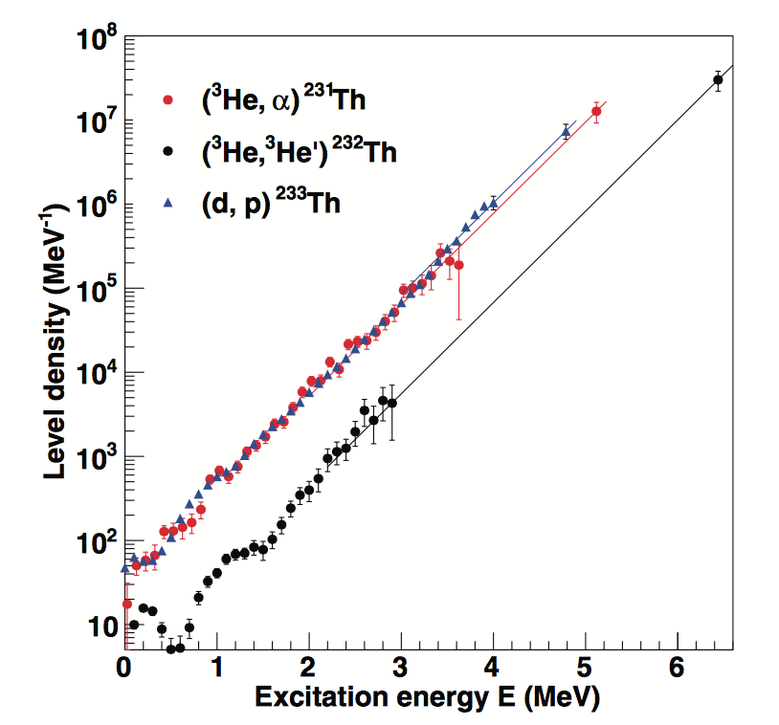
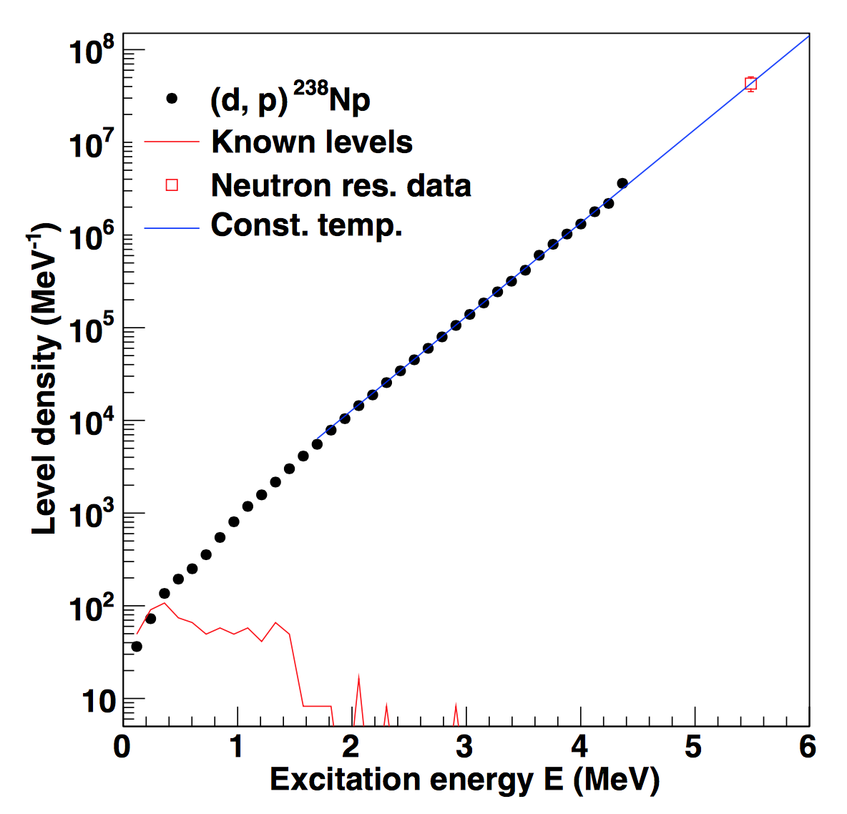
Actinides
Guttormsen et al., PRC 88, 024307 (2013)
Tornyi et al., PRC 89, 044323 (2014)

Slide 20
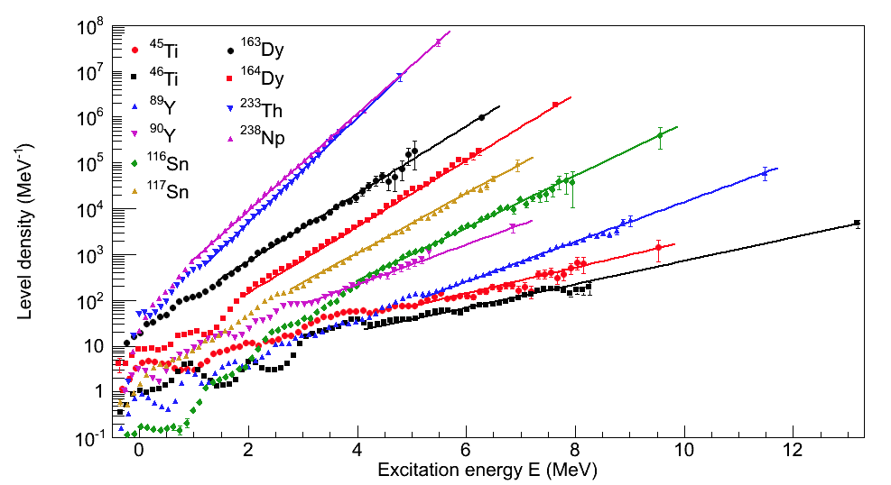
Summary of level densities using the Oslo method

Slide 21
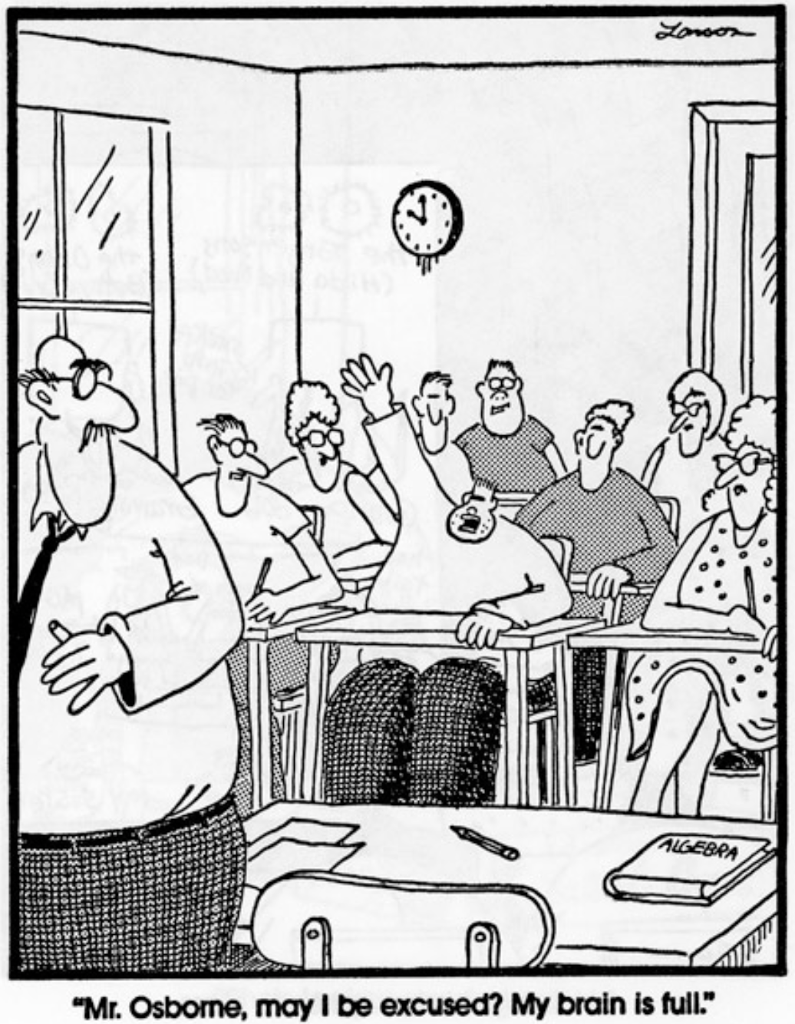
Thank you !
Mr. Osbome, may I be excused? My brain is full.

